Slide 1
Divide and Conquer

Slide 2
Divide and Conquer
Divide and Conquer algorithms consist of two parts:
  Divide: Smaller problems are solved recursively (except, of course, the base cases).
  Conquer: The solution to the original problem is then formed from the solutions to the subproblems.

Slide 3
Divide and Conquer
Traditionally
  Algorithms which contain at least 2 recursive calls are called divide and conquer algorithms, while algorithms with one recursive call are not.
Classic Examples
  Mergesort and Quicksort
    The problem is divided into smaller sub-problems.
Examples of recursive algorithms that are not Divide and Conquer
  Findset in a Disjoint Set implementation is not divide and conquer.
    Mostly because it doesn’t “divide” the problem into smaller sub-problems since it only has one recursive call.
  Even though the recursive method to compute the Fibonacci numbers has 2 recursive calls
    It’s really not divide and conquer because it doesn’t divide the problem.

Slide 4
This Lecture
Divide-and-conquer technique for algorithm design. Example problems:
  Integer Multiplication
  Subset Sum Recursive Problem
  Closest Points Problem
  Skyline Problem
  Strassen’s Algorithm
  Tromino Tiling
September 22, 2003

Slide 5
Integer Multiplication
The standard integer multiplication routine of 2 n-digit numbers
  Involves n multiplications of an n-digit number by a single digit
  Plus the addition of n numbers, which have at most 2 n digits
1011
x1111
1011
10110
101100
+1011000
10100101
quantity time
Multiplication n-digit by 1-digit n O(n)
Additions 2n-digit by n-digit max n O(n)
Total time = n*O(n) + n*O(n) = 2n*O(n) = O(n²)

Slide 6
Integer Multiplication
Let’s consider a Divide and Conquer Solution
  Imagine multiplying an n-bit number by another n-bit number.
    We can split up each of these numbers into 2 halves.
    Let the 1st number be I, and the 2nd number J
    Let the “left half” of the 1st number by I_{h} and the “right half” be I_{l}.
  So in this example: I is 1011 and J is 1111
    I becomes 10*2² + 11 where I_{h} = 10*2² and I_{l} = 11.
    and J_{h} = 11*2² and J_{l} = 11
1011
x1111
1011
10110
101100
+1011000
10100101

Slide 7
Integer Multiplication
So for multiplying any n-bit integers I and J
  We can split up I into (I_{h} * 2^{n/2}) + I_{l}
  And J into (J_{h} * 2^{n/2}) + J_{l}
Then we get
  I x J = [(I_{h} x 2^{n/2}) + I_{l}] x [(J_{h} x 2^{n/2}) + J_{l}]
  I x J = I_{h} x J_{h} x 2^{n} + (I_{l} x J_{h} + I_{h} x J_{l}) x 2^{n/2} + I_{l} x J_{l}
So what have we done?
  We’ve broken down the problem of multiplying 2 n-bit numbers into
    4 multiplications of n/2-bit numbers plus 3 additions.
  T(n) = 4T(n/2) + θ(n)
  Solving this using the master theorem gives us…
    T(n) = θ(n²)

Slide 8
Integer Multiplication
So we haven’t really improved that much,
  Since we went from a O(n²) solution to a O(n²) solution
Can we optimize this in any way?
  We can re-work this formula using some clever choices…
  Some clever choices of:
    P₁ = (I_{h} + I_{l}) x (J_{h} + J_{l}) = I_{h}xJ_{h} + I_{h}x J_{l} + I_{l}xJ_{h} + I_{l}xJ_{l}
    P₂ = I_{h} x J_{h} , and
    P₃ = I_{l} x J_{l}
  Now, note that
    P₁ - P₂ – P₃ = I_{h}xJ_{h} + I_{h}xJ_{l} + I_{l}xJ_{h} + I_{l}xJ_{l} - I_{h}xJ_{h} - I_{l}xJ_{l}
    = I_{h}xJ_{l} + I_{l}xJ_{h}
  Then we can substitute these in our original equation:
    I x J = P₂ x 2^{n} + [P₁ - P₂ – P₃]x 2^{n/2} + P₃.

Slide 9
Integer Multiplication
    I x J = P₂ x 2^{n} + [P₁ - P₂ – P₃]x 2^{n/2} + P₃.
Have we reduced the work?
  Calculating P2 and P3 – take n/2-bit multiplications.
  P1 takes two n/2-bit additions and then one n/2-bit multiplication.
  Then, 2 subtractions and another 2 additions, which take O(n) time.
This gives us : T(n) = 3T(n/2) + θ(n)
  Solving gives us T(n) = θ(n^{(log}2³⁾), which is approximately T(n) = θ(n^{1.585}), a solid improvement.

Slide 10
Integer Multiplication
Although this seems it would be slower initially because of some extra pre-computing before doing the multiplications, for very large integers, this will save time.
Q: Why won't this save time for small multiplications?
  A: The hidden constant in the θ(n) in the second recurrence is much larger. It consists of 6 additions/subtractions whereas the θ(n) in the first recurrence consists of 3 additions/subtractions.

Slide 11
Integer Multiplication Example
Shown on the board

Slide 12
Tromino Tiling
A tromino tile:
And a 2^{n}x2^{n} board with a hole:
A tiling of the board with trominos:

Slide 13
Tiling: Trivial Case (n = 1)
Trivial case (n = 1): tiling a 2x2 board with a hole:
Idea – try somehow to reduce the size of the original problem, so that we eventually get to the 2x2 boards which we know how to solve…

Slide 14
Tiling: Dividing the Problem
To get smaller square boards let’s divide the original board into for boards
Great! We have one problem of the size 2^{n-1}x2^{n-1}!
But: The other three problems are not similar to the original problems – they do not have holes!

Slide 15
Tiling: Dividing the Problem
Idea: insert one tromino at the center to get three holes in each of the three smaller boards
Now we have four boards with holes of the size 2^{n-1}x2^{n-1}.
Keep doing this division, until we get the 2x2 boards with holes – we know how to tile those

Slide 16
Tiling: Algorithm
INPUT: n – the board size (2^{n}x2^{n} board), L – location of the hole.
OUTPUT: tiling of the board
Tile(n, L)
if n = 1 then
Trivial case
Tile with one tromino
return
Divide the board into four equal-sized boards
Place one tromino at the center to cut out 3 additional holes
Let L1, L2, L3, L4 denote the positions of the 4 holes
Tile(n-1, L1)
Tile(n-1, L2)
Tile(n-1, L3)
Tile(n-1, L4)

Slide 17
Divide and Conquer
Divide-and-conquer method for algorithm design:
  If the problem size is small enough to solve it in a straightforward manner, solve it. Else:
    Divide: Divide the problem into two or more disjoint subproblems
    Conquer: Use divide-and-conquer recursively to solve the subproblems
    Combine: Take the solutions to the subproblems and combine these solutions into a solution for the original problem

Slide 18
Tiling: Divide-and-Conquer
Tiling is a divide-and-conquer algorithm:
  Just do it trivially if the board is 2x2, else:
  Divide the board into four smaller boards (introduce holes at the corners of the three smaller boards to make them look like original problems)
  Conquer using the same algorithm recursively
  Combine by placing a single tromino in the center to cover the three introduced holes

Slide 19
Tromino Tiling Example
http://oneweb.utc.edu/~Christopher-Mawata/trominos/

Slide 20
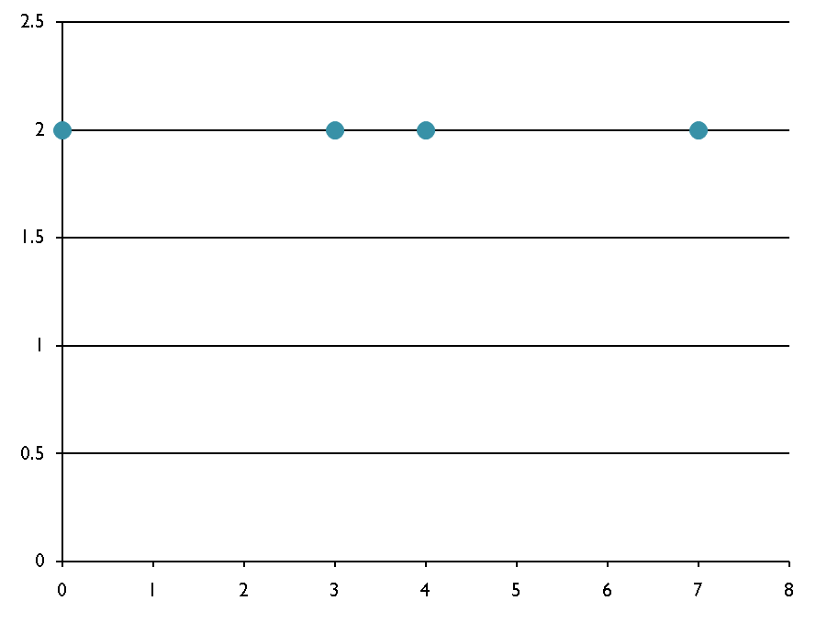
Finding the Closest Pair of Points
Problem:
  Given n ordered pairs (x₁ , y₁), (x₂ , y₂), ... , (x_{n} , y_{n}), find the distance between the two points in the set that are closest together.

Slide 21
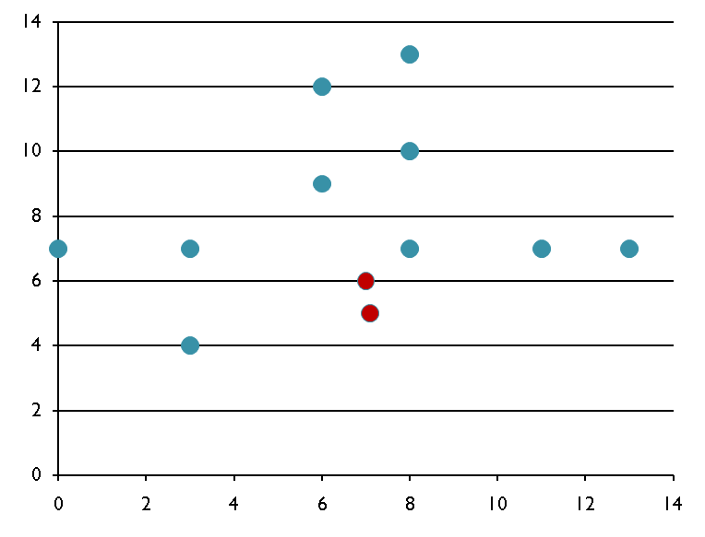
Closest-Points Problem
Brute Force Algorithm
  Iterate through all possible pairs of points, calculating the distance between each of these pairs. Any time you see a distance shorter than the shortest distance seen, update the shortest distance seen.
Since computing the distance between two points takes O(1) time,
And there are a total of
n(n-1)/2= θ(n²) distinct pairs of points,
It follows that the running time of this algorithm is θ(n²).
Can we do better?

Slide 22
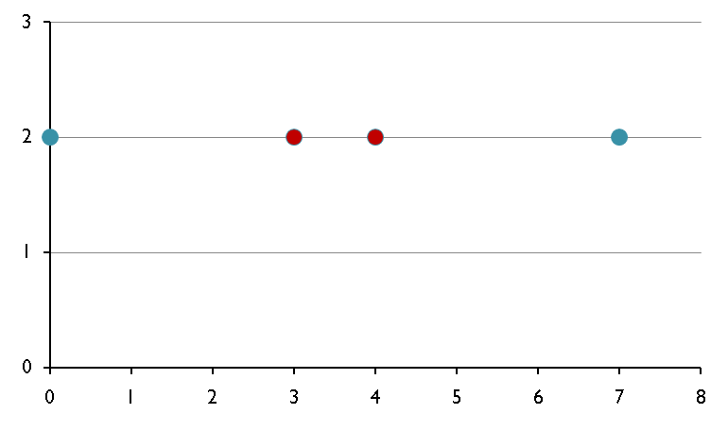
Closest-Points Problem
Here’s the idea:
  Split the set of n points into 2 halves by a vertical line.
    Do this by sorting all the points by their x-coordinate and then picking the middle point and drawing a vertical line just to the right of it.
  Recursively solve the problem on both sets of points.
  Return the smaller of the two values.
What’s the problem with this idea?

Slide 23
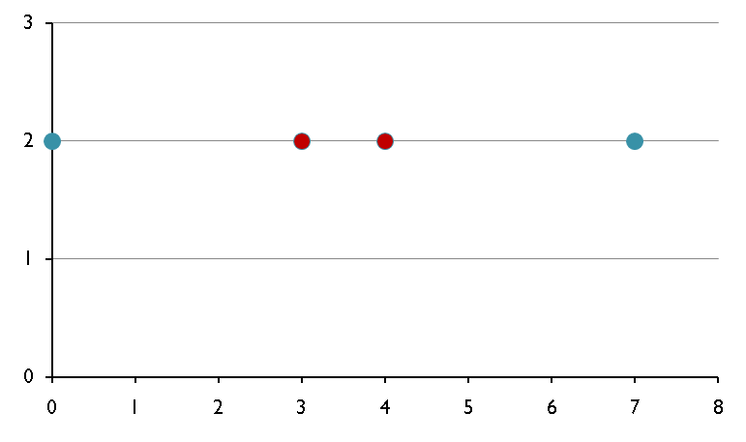
Closest Points Problem
The problem is that the actual shortest distance between any 2 of the original points MIGHT BE between a point in the 1st set and a point in the 2nd set! Like in this situation:
So we would get a shortest distance of 3, instead of 1.

Slide 24

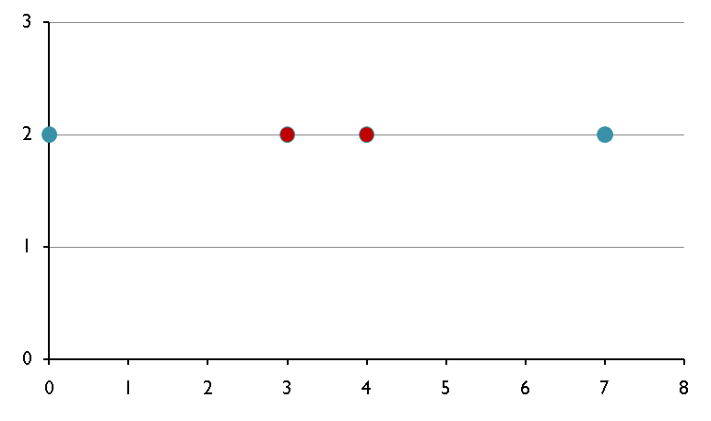
Original idea:
  Split the set of n points into 2 halves by a vertical line.
    Do this by sorting all the points by their x-coordinate and then picking the middle point and drawing a vertical line just to the right of it.
  Recursively solve the problem on both sets of points.
  Return the smaller of the two values.
We must adapt our approach:
  In step 3, we can “save” the smaller of the two values (called δ), then we have to check to see if there are points that are closer than δ apart.
δ
  Do we need to search thru all possible pairs of points from the 2 different sides?
    NO, we can only consider points that are within δ of our dividing line.

Slide 25
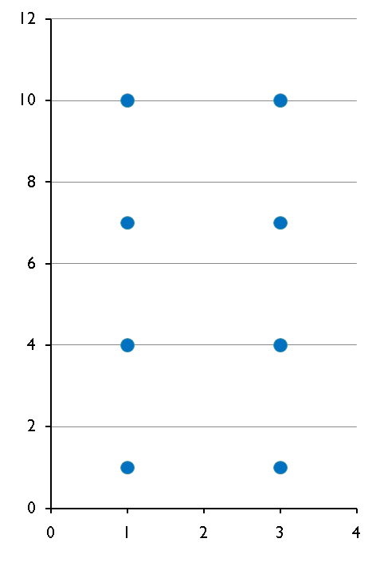
Closest Points Problem
However, one could construct a case where ALL the points on each side are within δ of the vertical line:
So, this case is as bad as our original idea where we’d have to compare each pair of points to one another from the different groups.
  But, wait!! Is it really necessary to compare each point on one side with every other point on every other side???

Slide 26
Closest Points Problem
Consider the following rectangle around the dividing line that is constructed by eight δ/2 x δ/2 squares.
Note that the diagonal of each square is δ/√2 , which is less than δ.
Since each square lies on a single side of the dividing line, at most one point lies in each box
  Because if 2 points were within a single box the distance between those 2 points would be less than δ.
Therefore, there are at MOST 7 other points that could possibly be a distance of less than δ apart from a given point, that have a greater y coordinate than that point.
  (We assume that our point is on the bottom row of this grid; we draw the grid that way.)

Slide 27
Closest Points Problem
Now we have the issue of how do we know which 7 points to compare a given point with?
The idea is:
  As you are processing the points recursively, SORT them based on the y-coordinate.
Then for a given point within the strip, you only need to compare with the next 7 points.

Slide 28
Closest Points Problem
Now the Recurrence relation for the runtime of this problem is:
  T(n) = T(n/2) + O(n)
  Which is the same as Mergesort, which we’ve shown to be O(n log n).

Slide 29
ClosestPair(ptsByX, ptsByY, n)
if (n = 1) return 1
if (n = 2) return distance(ptsByX[0], ptsByX[1])
// Divide into two subproblems
mid ← n/2 -1
copy ptsByX[0 . . . mid] into new array XL in x order.
copy ptsByX[mid+1 . . . n − 1] into new array XR
copy ptsByY into arrays Y L and Y R in y order, s.t.
XL and Y L refer to same points, as do XR,Y R.
// Conquer
distL ← ClosestPair(XL, Y L, n/2)
distR ← ClosestPair(XR, Y R, n/2)
// Combine
midPoint ptsByX[mid]
lrDist min(distL, distR)
Construct array yStrip, in increasing y order,
of all points p in ptsByY s.t.
|p.x − midPoint.x| < lrDist
// Check yStrip
minDist ← lrDist
for (j← 0; j ≤ yStrip.length − 2; j++) {
k ← j + 1
while (k yStrip.length − 1 and
yStrip[k].y − yStrip[j].y < lrDist) {
d ← distance(yStrip[j], yStrip[k])
minDist ← min(minDist, d)
k++
}
}
return minDist

Slide 30
closest_pair(p) {
mergesort(p, 1, n) // n is number of points
return rec_cl_pair(p, 1, 2)
}
rec_cl_pair(p, i, j) {
if (j - i < 3) { \\ If there are three points or less...
mergesort(p, i, j) // based on y coordinate
return shortest_distance(p[i], p[i+1], p[i+2])
}
xval = p[(i+j)/2].x
deltaL = rec_cl_pair(p, i, (i+j)/2)
deltaR = rec_cl_pair(p, (i+j)/2+1, j)
delta = min(deltaL, deltaR)
merge(p, i, j) // merge points based on y coordinate
v = vert_strip(p, xval, delta)
for k=1 to size(v)-1
for s = (k+1) to min(t, k+7)
delta = min(delta, dist(v[k], v[s]))
return delta
}

Slide 31
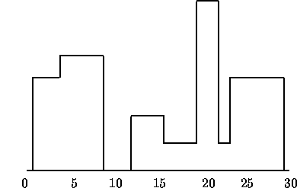
Skyline Problem
You are to design a program to assist an architect in drawing the skyline of a city given the locations of the buildings in the city.
  To make the problem tractable, all buildings are rectangular in shape and they share a common bottom (the city they are built in is very flat).
A building is specified by an ordered triple (Li, Hi, Ri)
  where Li and Ri are left and right coordinates, respectively, of building i and Hi is the height of the building.
  Below the single building is specified by (1,11,5)
10
5
0
0
5

Slide 32
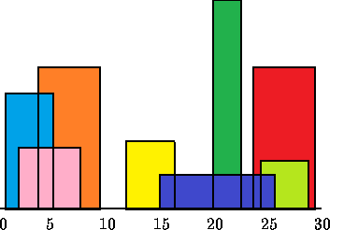
Skyline Problem
In the diagram below buildings are shown on the left with triples :
  (1,11,5), (2,6,7), (3,13,9), (12,7,16), (14,3,25), (19,18,22), (23,13,29), (24,4,28)
The skyline of those buildings is shown on the right, represented by the sequence:
  (1, 11, 3, 13, 9, 0, 12, 7, 16, 3, 19, 18, 22, 3, 23, 13, 29, 0)

Slide 33
Skyline Problem
We can solve this problem by separating the buildings into two halves and solving those recursively and then Merging the 2 skylines.
  Similar to merge sort.
  Requires that we have a way to merge 2 skylines.
Consider two skylines:
  Skyline A: a₁, h₁₁, a₂, h₁₂, a₃, h₁₃, …, a_{n}, 0
  Skyline B: b₁, h₂₁, b₂, h₂₂, b₃, h₂₃, …, b_{m}, 0
Merge(list of a’s, list of b’s)
  (c₁, h₁₁, c₂, h₂₁, c₃, …, c_{n+m}, 0)

Slide 34
Skyline Problem
Clearly, we merge the list of a's and b's just like in the standard Merge algorithm.
  But, it addition to that, we have to properly decide on the correct height in between each set of these boundary values.
  We can keep two variables, one to store the current height in the first set of buildings and the other to keep the current height in the second set of buildings.
  Basically we simply pick the greater of the two to put in the gap.
After we are done, (or while we are processing), we have to eliminate redundant "gaps", such as 8, 15, 9, 15, 12, where there is the same height between the x-coordinates 8 and 9 as there is between the x-coordinates 9 and 12.
  (Similarly, we will eliminate or never form gaps such as 8, 15, 8, where the x-coordinate doesn't change.)

Slide 35
Skyline Problem - Runtime
Since merging two skylines of size n/2 should take O(n), letting T(n) be the running time of the skyline problem for n buildings, we find that T(n) satisfies the following recurrence:
  T(n) = 2T(n/2) + O(n)
Thus, just like Merge Sort, for the Skyline problem T(n) = O(nlgn)

Slide 36
Announcements
Assignment #3 – The Zombie Outbreak Problem – Due this Wednesday 10/20/2010
I’m going to try to give practice problems in class that you can earn extra points on the exam.
  If you already earned 3 pts for the next exam you can’t earn 3 more.
  BUT after the next exam you can start earning points for the final.

Slide 37
Summary
Divide and Conquer Algorithms we have seen so far:
  Integer Multiplication
  Tromino Tiling
  Closest Pair of Points Problem
  Skyline Problem
  Subset Sum Recursive Problem
Today – Finish Divide and Conquer
  Strassen’s algorithm for matrix multiplication
  Summary of Divide and Conquer
Start on Dynamic Programming

Slide 38
Subset Sum Recursive Problem
Given n items and a target value, T, determine whether there is a subset of the items such that their sum equals T.
  Determine whether there is a subset S of {1, …, n} such that the elements of S add up to T.
Two cases:
  Either there is a subset S in items {1, …, n-1} that adds up to T.
  Or there is a subset S in items {1,…, n-1} that adds up to T – n, where S U {n} is the solution.
public static boolean SS(int[] vals, int target, int length,
String numbers)
The divide-and-conquer algorithm based on this recursive solution has a running time given by the recurrence:
  T(n) = 2T(n-1) + O(1)

Slide 39
Subset Sum Recursive Problem
public class subsetsumrec {
public static boolean SS(int[] vals, int target, int length,
String numbers) {
// Empty set satisfies this target.
if (target == 0) {
System.out.println(numbers);
return true;
}
// An empty set can't add up to a non-zero value.
if (length == 0)
return false;
return SS(vals, target - vals[length-1], length-1, numbers+", "+vals[length-1]) ||
SS(vals, target, length-1, numbers ); } }

Slide 40
Subset Sum Recursive Example
Shown on the board

Slide 41

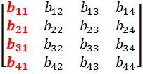
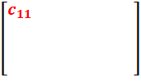
Strassen’s Algorithm
A fundamental numerical operation is the multiplication of 2 matrices.
  The standard method of matrix multiplication of two n x n matrices takes T(n) = O(n3).
X
=
The following algorithm multiples n x n matrices A and B:
// Initialize C.
for i = 1 to n
for j = 1 to n
for k = 1 to n
C [i, j] += A[i, k] * B[k, j];

Slide 42

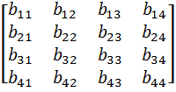

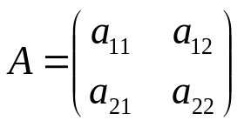
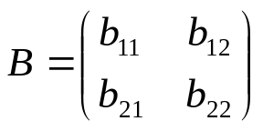
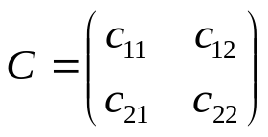





Strassen’s Algorithm
We can use a Divide and Conquer solution to solve matrix multiplication by separating a matrix into 4 quadrants:
X
=
Then we know have:
if
, then we have the following:
8 n/2 * n/2 matrix multiples + 4 n/2 * n/2 matrix additions
T(n) = 8T(n/2) + O(n²)
If we solve using the master theorem we still have O(n³)

Slide 43
Strassen’s Algorithm
Strassen showed how two matrices can be multiplied using only 7 multiplications and 18 additions:
  Consider calculating the following 7 products:
    q₁ = (a₁₁ + a₂₂) * (b₁₁ + b₂₂)
    q₂ = (a₂₁ + a₂₂) * b₁₁
    q₃ = a₁₁*( b₁₂ – b₂₂)
    q₄ = a₂₂ * (b₂₁ – b₁₁)
    q₅ = (a₁₁ + a₁₂) * b₂₂
    q₆ = (a₂₁ – a₁₁) * (b₁₁ + b₁₂)
    q₇ = (a₁₂ – a₂₂) * (b₂₁ + b₂₂)
  It turns out that
    c₁₁ = q₁ + q₄ – q₅ + q₇
    c₁₂ = q₃ + q₅
    c₂₁ = q₂ + q₄
    c₂₂ = q₁ + q₃ – q₂ + q₆

Slide 44
Strassen’s Algorithm
Let’s verify one of these:
  Given:
if
, we know:
Strassen’s Algorithm states:
  c₂₁ = q₂ + q₄,
  where q₄ = a₂₂ * (b₂₁ – b₁₁) and q₂ = (a₂₁ + a₂₂) * b₁₁

Slide 45
Strassen’s Algorithm
 | Mult | Add | Recurrence Relation | Runtime
Regular | 8 | 4 | T(n) = 8T(n/2) + O(n²) | O(n³)
Strassen | 7 | 18 | T(n) = 7T(n/2) + O(n²) | O(n ^{log27}) = O(n^{2.81})

Slide 46
Strassen’s Algorithm
I have no idea how Strassen came up with these combinations.
  He probably realized that he wanted to determine each element in the product using less than 8 multiplications.
    From there, he probably just played around with it.
If we let T(n) be the running time of Strassen's algorithm, then it satisfies the following recurrence relation:
  T(n) = 7T(n/2) + O(n²)
    It's important to note that the hidden constant in the O(n²) term is larger than the corresponding constant for the standard divide and conquer algorithm for this problem.
  However, for large matrices this algorithm yields an improvement over the standard one with respect to time.

Slide 47
Divide-and-Conquer Summary
The most-well known algorithm design strategy:
Divide instance of problem into two or more smaller instances
Solve smaller instances recursively
Obtain solution to original (larger) instance by combining these solutions

Slide 48
Divide-and-Conquer Technique
a problem of size n
subproblem 1
of size n/2
subproblem 2
of size n/2
a solution to
subproblem 1
a solution to
subproblem 2
a solution to
the original problem
It general leads to a recursive algorithm!

Slide 49
Divide-and-Conquer Examples
Sorting: mergesort and quicksort
Binary tree traversals
The Algorithms we’ve reviewed:
  Integer Multiplication
  Tromino Tiling
  Closest Pair of Points Problem
  Skyline Problem
  Subset Sum Recursive Problem
  Strassen’s Algorithm for Matrix Multiplication

Slide 50
General Divide-and-Conquer Recurrence
T(n) = aT(n/b) + f (n) where f(n) ∈ Θ(n^{d}), d ≥ 0
Master Theorem: If a < b^{d}, T(n) ∈ Θ(n^{d})
If a = b^{d}, T(n) ∈ Θ(n^{d} log n)
If a > b^{d}, T(n) ∈ Θ(n^{log b a} )
Note: The same results hold with O instead of Θ.
Examples: T(n) = 4T(n/2) + n ⇒ T(n) ∈ ?
T(n) = 4T(n/2) + n² ⇒ T(n) ∈ ?
T(n) = 4T(n/2) + n³ ⇒ T(n) ∈ ?
T(n) = 4T(n/4) + n ⇒ T(n) ∈ ?
(Tromino Tiling)
T(n) = 7T(n/2) + n² ⇒ T(n) ∈ ?
(Strassen’s Algorithm for Matrix Multiplication)
Θ(n²)
Θ(n² log n)
Θ(n³)
Θ(n log n)
Θ(n ^{log27}) = Θ(n ^{2.1})

Slide 51
References
Slides adapted from Arup Guha’s Computer Science II Lecture notes: http://www.cs.ucf.edu/~dmarino/ucf/cop3503/lectures/
Additional material from the textbook:
  Data Structures and Algorithm Analysis in Java (Second Edition) by Mark Allen Weiss
Additional images:
  www.wikipedia.com
  xkcd.com

